Slide 1
Data Communication and Networking Semester project

Slide 2
Title: High Availability Web Server Network Using Dynamic Routing, Load Balancing, and Failover

Slide 3
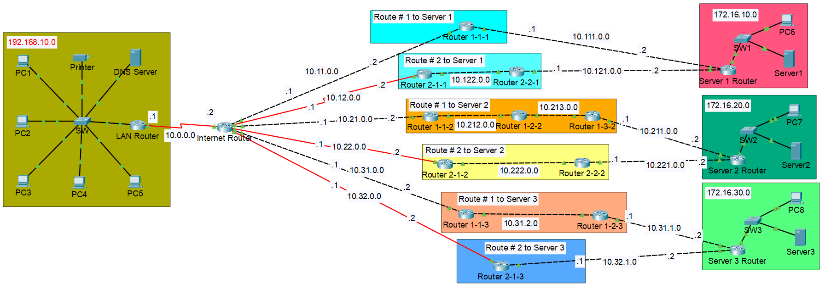
Network Topology

Slide 4
Key features
Dynamic IP assignment using DHCP
Dynamic Routing using OSPF
Failover Mechanism
Optimally sized subnets for point-to-point connections
Efficient IP addressing across the network
Scalable Networks on client and server side
Automatic Route learning on new path addition to network

Slide 5
How Dynamic routing works
Whenever a new Route is available to a router which has OSPF enabled on it, it develops an ‘adjacency’ with it. Every router with OSPF enabled advertises its adjacencies which helps Routers create a ‘map-like’ structure in its memory, we can actually see it in for of “O-type” routes in the output of ‘show ip route’ command on routers.
Lets see how it works:

Slide 6
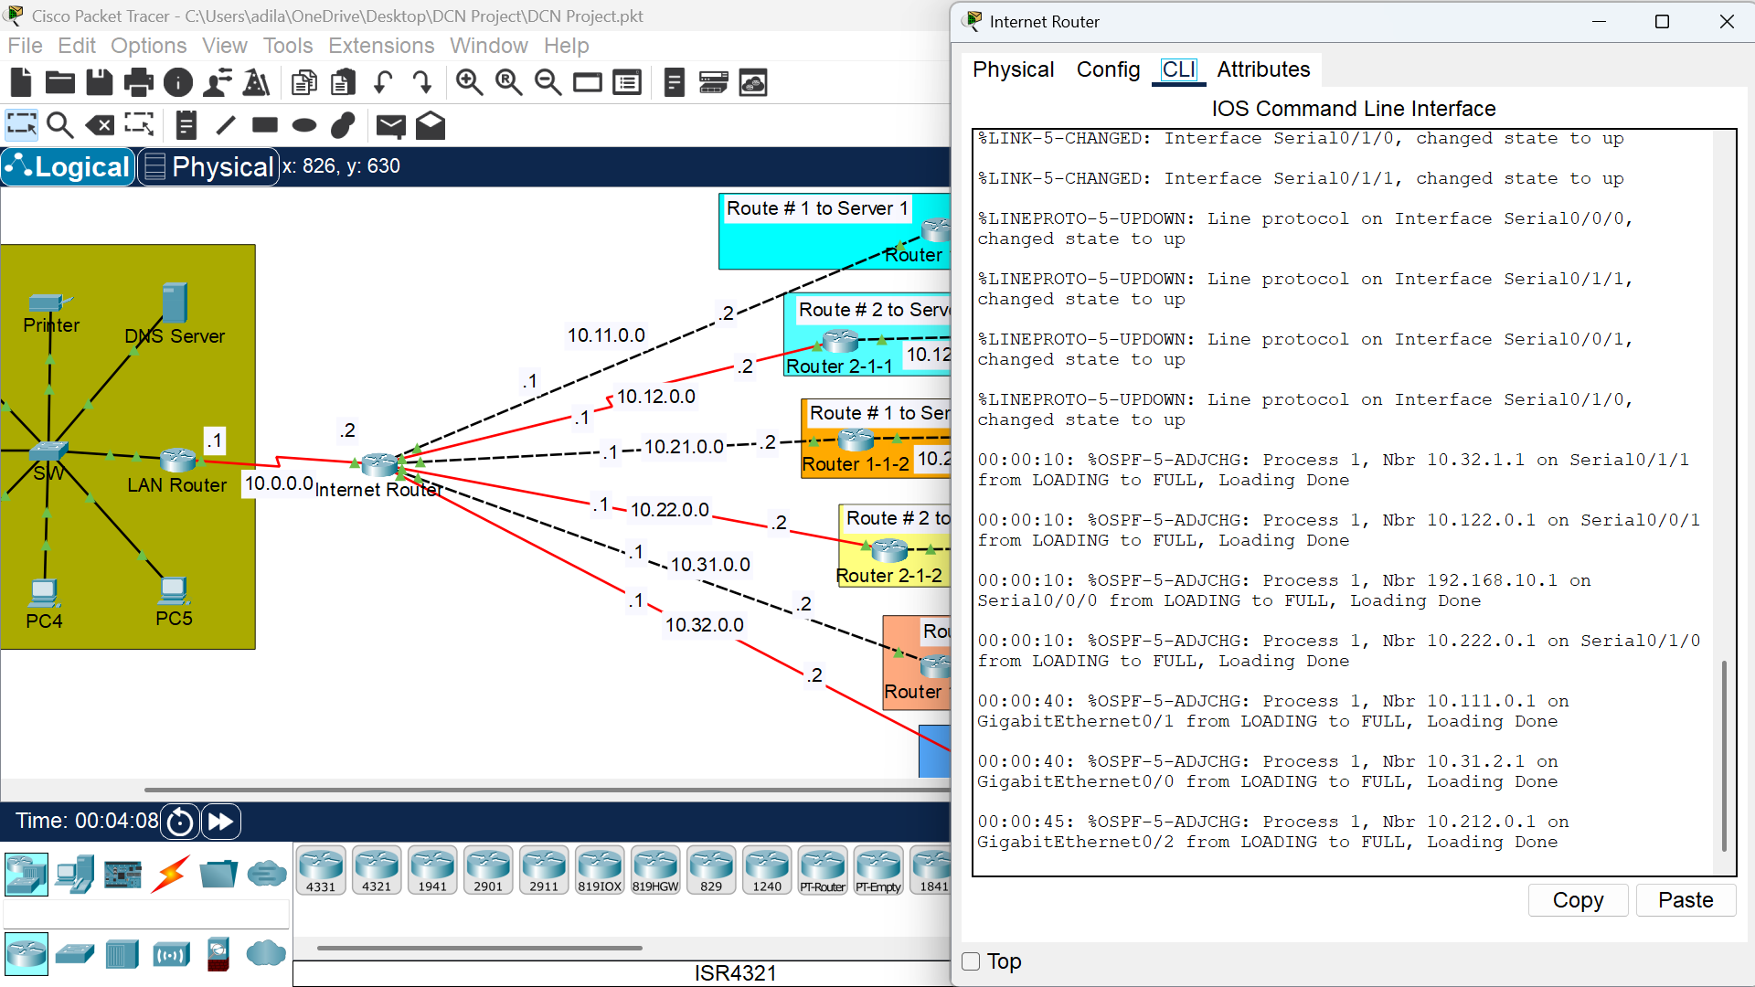
How Dynamic routing works

Slide 7
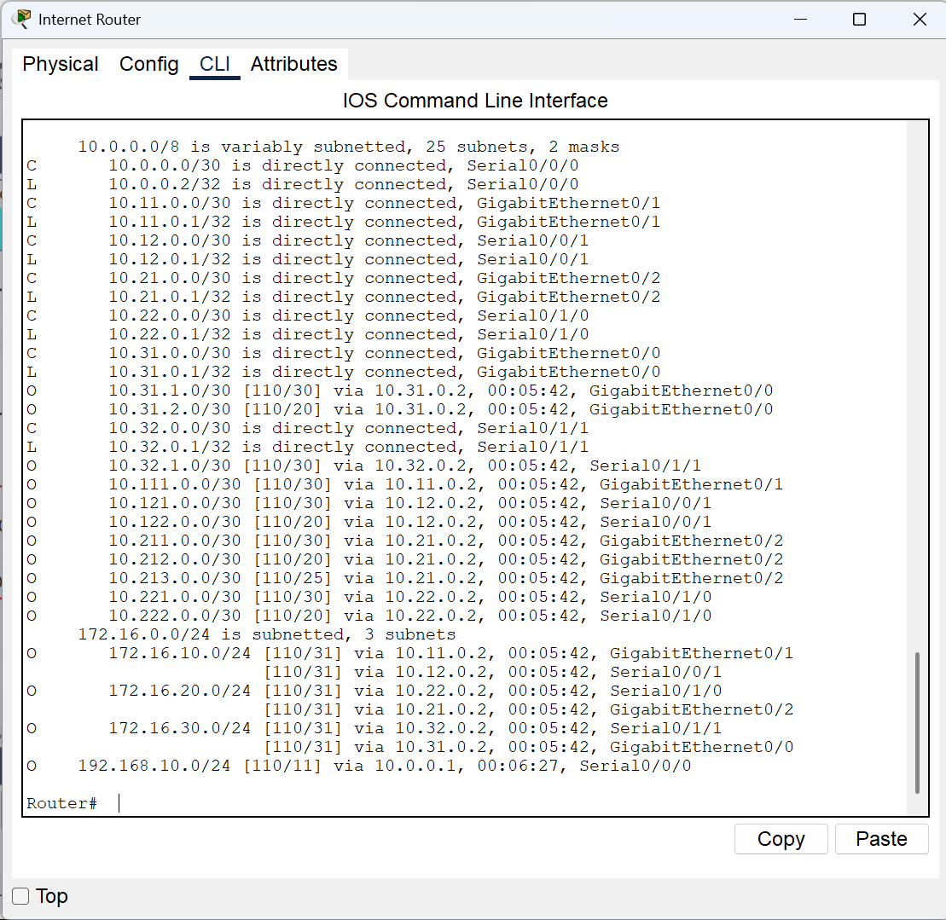
How Dynamic routing works

Slide 8
How Failover works
Failover means when a route to a destination gets down due to some reasons and the router, without any manual intervention, finds a new path to destination if possible.
We can see it happening live in the routing table that when a connection dies, another one takes its place.
Moreover, this can be confirmed in simulation mode as well.
Lets see how it works:

Slide 9
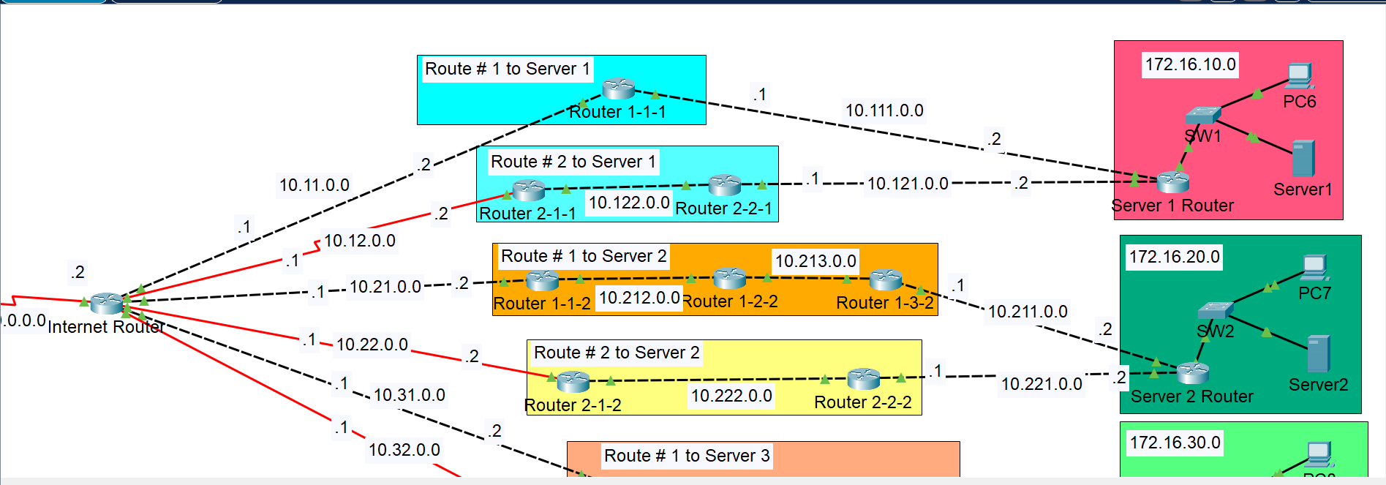
How Failover works
Two possible paths to same destination

Slide 10
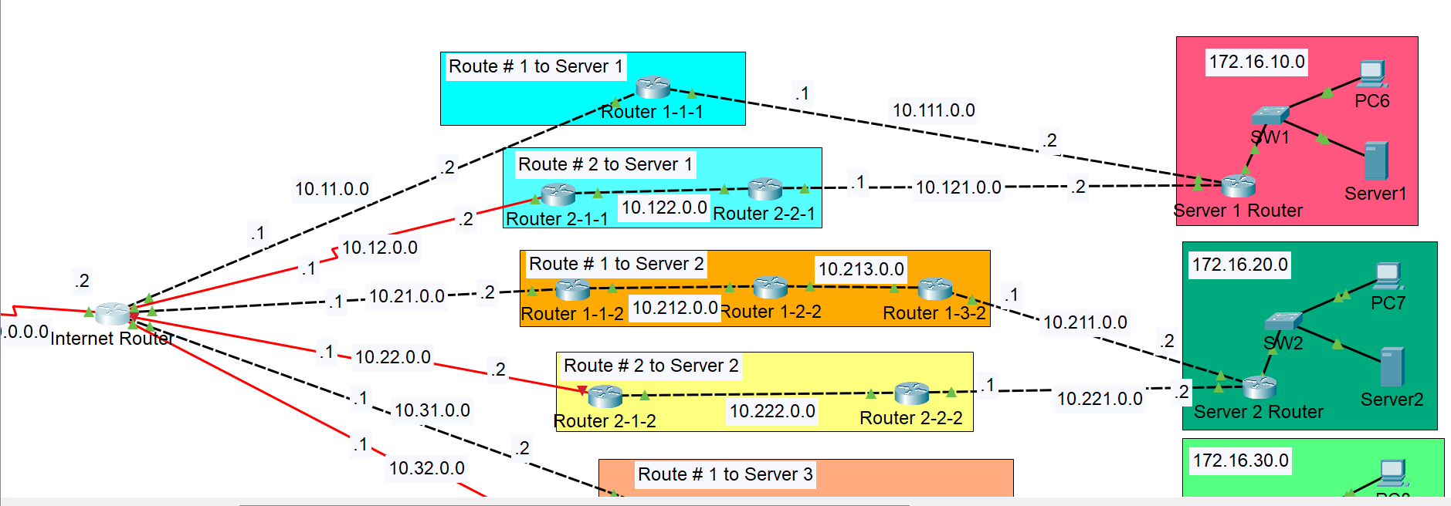
How Failover works
Second Path dies

Slide 11
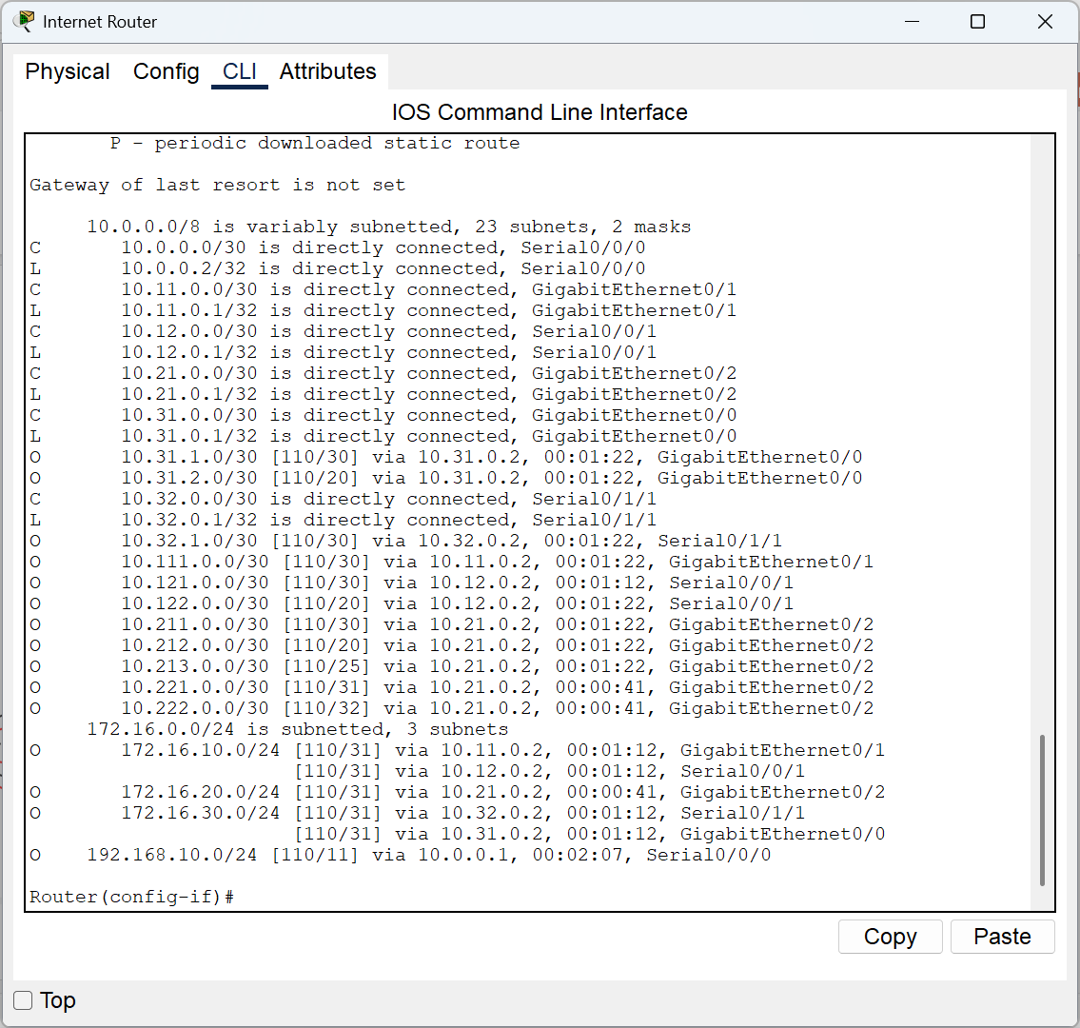
How Failover works

Slide 12
How Load balancing works
Load Balancing means to share the load / traffic across multiple ECMPs.
ECMP stands for “Equi-Cost Multi-Path”. In simple words, two or more paths to a common destination are said to be ECMPs if they have equal cost of reaching that common destination.
Redundant paths / routes were set-up for showcasing the working of ECMP Load Balancing
Lets see how it works:

Slide 13
How Load balancing works

Slide 14
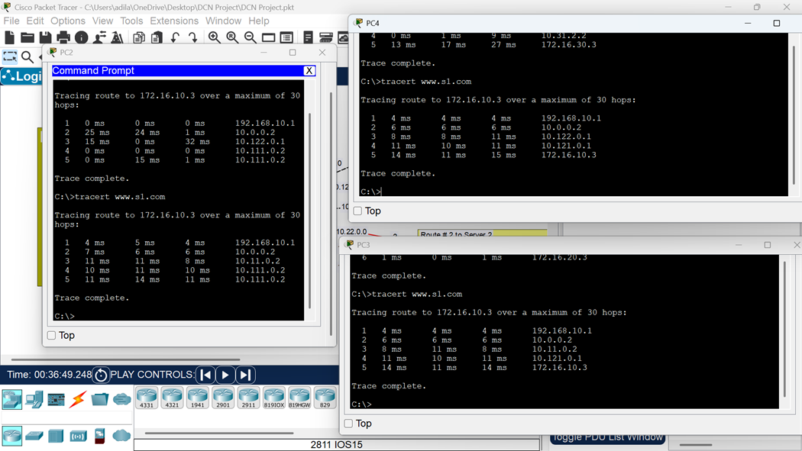
How Load balancing works

Slide 15
THANK YOU
BYE

